Slide 1


MRC, ASPR and HOSA-Future Health Professionals: Working Together to Engage Youth
CAPT Rob Tosatto
September 2015
Resilient People. Healthy Communities. A Nation Prepared.

Slide 2
HHS
OASH
ASPR
Surgeon General
OEM
PREP Division
MRC

Slide 3
HHS
OASH
ASPR
OSG
OEM
PREP Division
MRC

Slide 4
To Cover Today:
What is ASPR?
Status of the MRC
Status of our relationship with HOSA
What’s next???

Slide 5
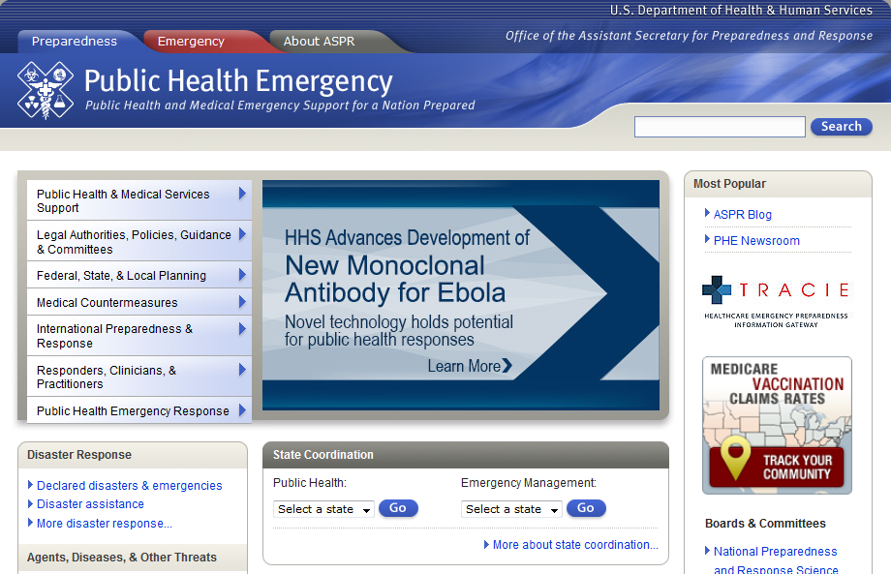

Slide 6

National Health Security Strategy
Vision
A nation that is secure and resilient in the face of diverse incidents with health consequences, with people in all communities enjoying a high level of security against threats to their health and well-being
Goal
To strengthen and sustain communities’ abilities to prevent, protect against, mitigate the effects of, respond to, and recover from incidents with negative health consequences
Notes:
Addresses all hazards – intentional or naturally occurring, CBRNE, infectious diseases, severe weather, environmental hazards
Identifies the intersections of health security and national, homeland, global health security
Is a national – not just Federal – strategy that enlists whole community partners and shared responsibility among virtually all segments of society
Provides strategic direction to ensure that efforts to improve health security nationwide over the next four years are guided by a common vision; based on sound evidence; and carried out in an efficient, collaborative manner
Identifies current priorities for enhancing national health security
Informs policies, resources, programs, and activities at all levels of government and across sectors to enhance national health security

Slide 7


Slide 8
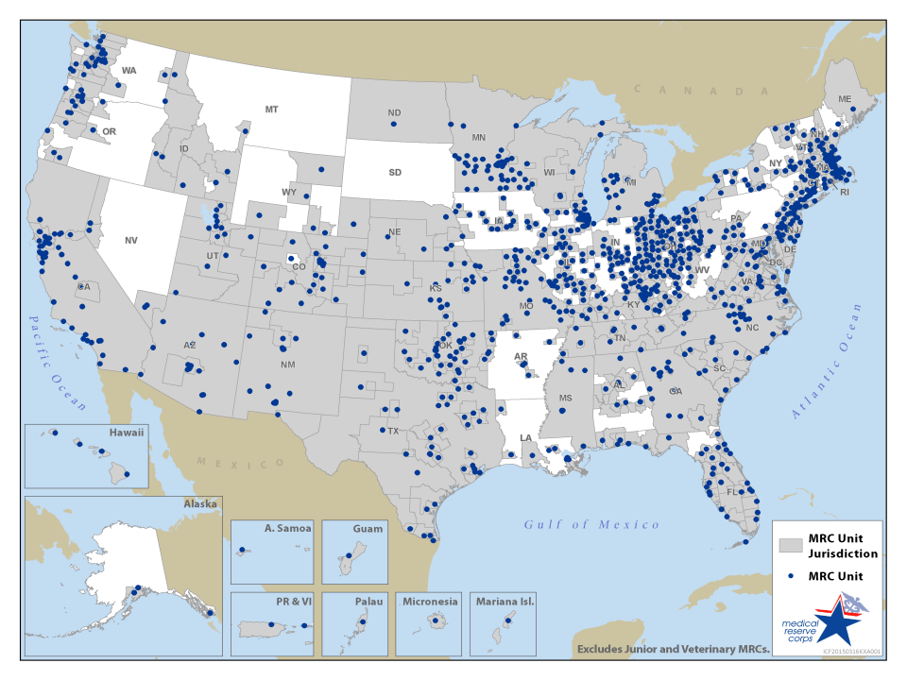
Notes:
About 1,000 MRC Units
49 states
Most territories
~91% U.S. Population Covered
~74% U.S. Area Covered

Slide 9
MRC Volunteers
Notes:
Over 200,000 MRC Volunteers

Slide 10

MRC Network Profile
Composition
Impact
Administration
http://www.naccho.org/topics/emergency/MRC/networkprofile

Slide 11
MRC Activities

Slide 12
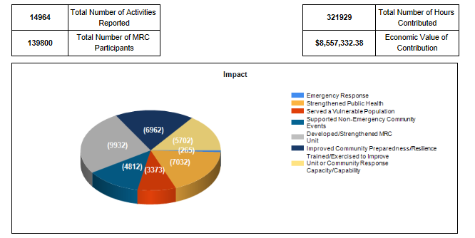
MRC Activities

Slide 13
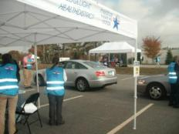
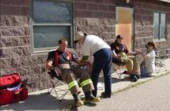
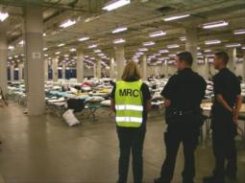
Emergency Response
Medical Shelter Support
Disaster Behavioral Health
General Shelter Support (Human or Animal)
EOC Support
Vaccinations/Mass Dispensing
Hospital ACS/Med Surge
Wellness Checks
Radiological Reception Centers
Search and Rescue
Volunteer Reception Center
Mass Casualty
Evacuation
Call Center/Communications Support
Epidemiology/Surveillance Support

Slide 14
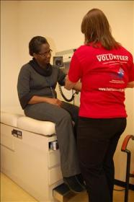
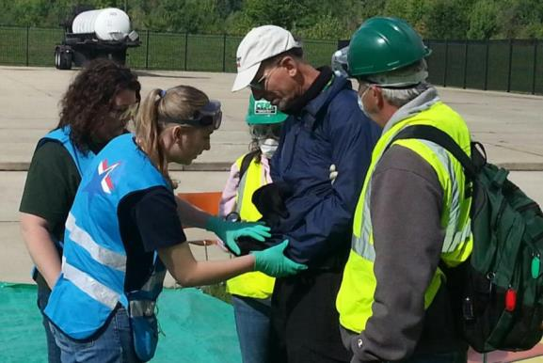
“Steady State”
Notes:
Engage volunteers
Training/experience
Benefits community!
14

Slide 15
Find MRC Information
Website\Find Nearest MRC Unit
  www.medicalreservecorps.gov
  www.medicalreservecorps.gov/FindMRC
Email
  MRCcontact@hhs.gov
Facebook
  www.facebook.com/medicalreservecorps
Twitter
  @MRC_ASPR
  www.twitter.com/MRC_ASPR
Listservs
  medicalreservecorps.gov/pageViewFldr/MRCListservs

Slide 16
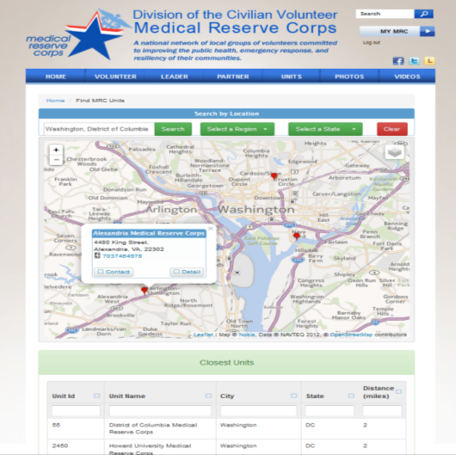
Find Nearest MRC Unit
http://www.medicalreservecorps.gov/FindMRC

Slide 17
Connect with MRC State and Regional Coordinators
Regional Coordinators: https://www.medicalreservecorps.gov/pageViewFldr/Coordinators/Regional
State Coordinators: https://www.medicalreservecorps.gov/StateCoordinators.aspx

Slide 18
Relationship with HOSA:
NLC
Notes:
18

Slide 19
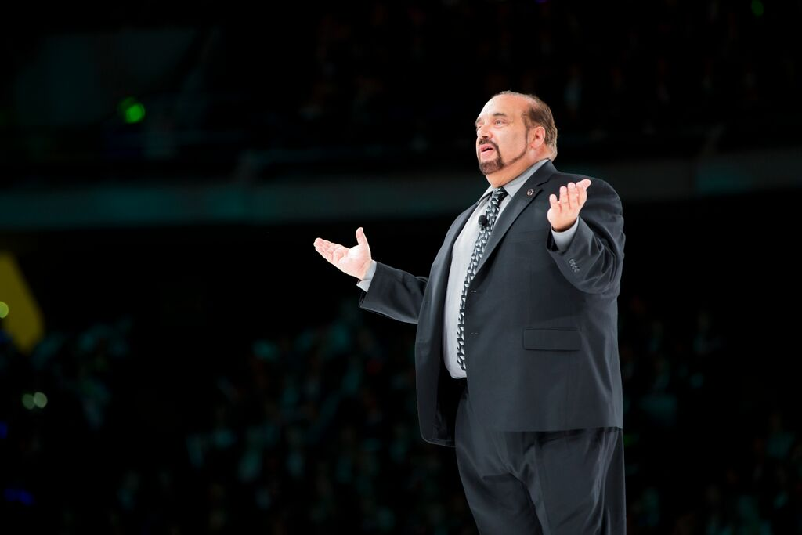
Relationship with HOSA:
NLC
Notes:
opening, recognition, and awards ceremonies
19

Slide 20
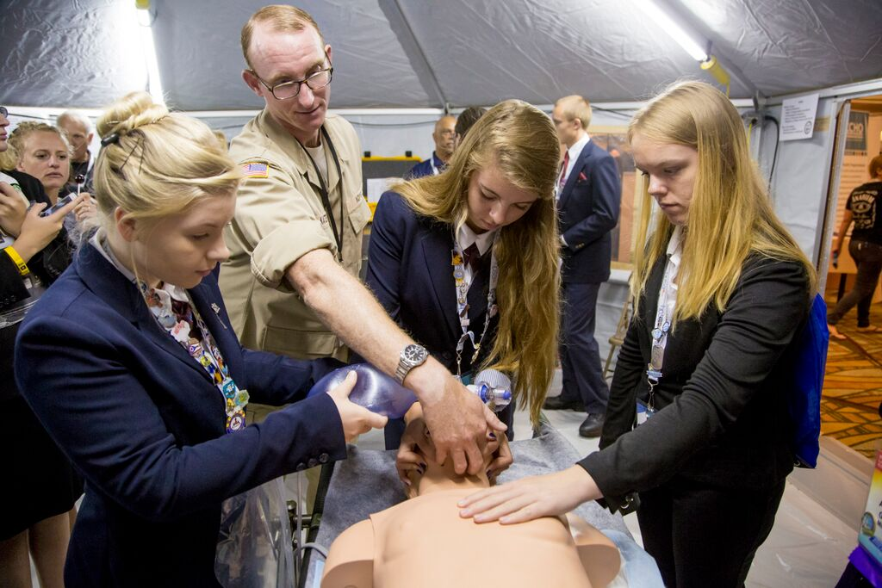
Relationship with HOSA:
NLC
Notes:
exhibit tables and the DMAT tent
20

Slide 21

Relationship with HOSA:
NLC
Notes:
led the morning “healthy start” workouts
21

Slide 22
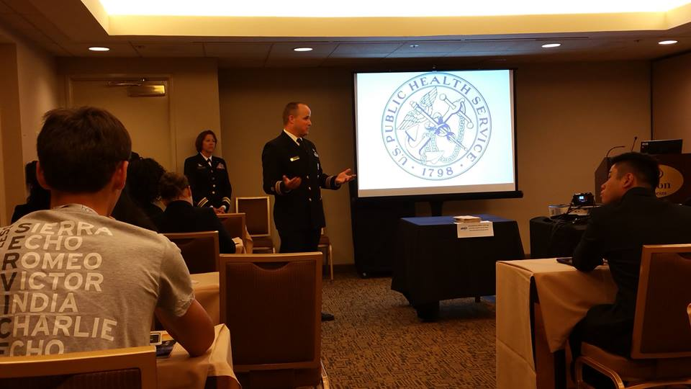
Relationship with HOSA:
NLC
Notes:
presented 11 workshops
22

Slide 23
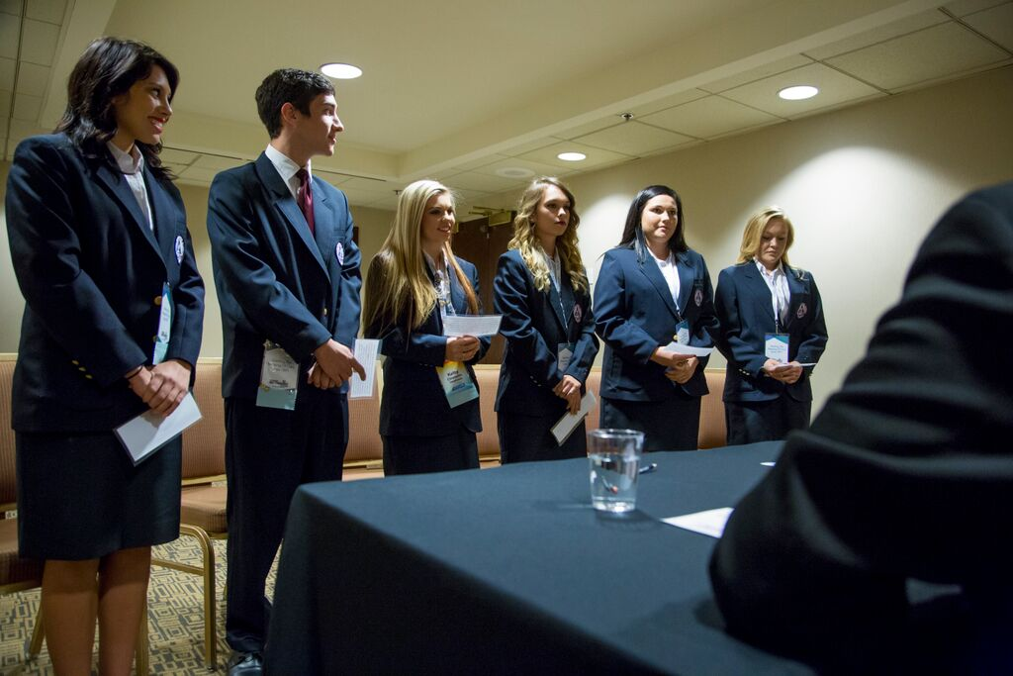
Relationship with HOSA:
NLC
Notes:
judged 6 competitive events
23

Slide 24

Relationship with HOSA:
NLC
Notes:
Including the MRC Partnership
1 Grayson Co Technology Center KY
2 Castle High School HI
3 Homer Hanna High School 7016 TX
4 Arlington High School 5816 TX
5 East Haven High School CT
6 MAST @ Homestead FL
7 Onate High School NM
8 MAST @ Homestead FL
9 Harrodsburg ATC KY
10 Covington High School TN
24

Slide 25

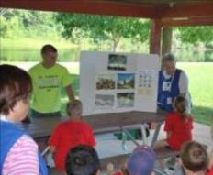
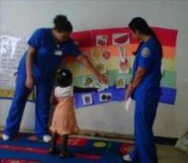

Relationship with HOSA:
Youth Engagement in the MRC
Notes:
25

Slide 26
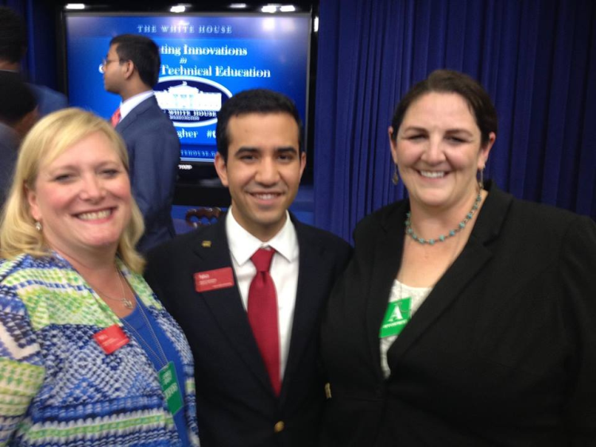
Relationship with HOSA:
Junior MRCs
Notes:
26

Slide 27
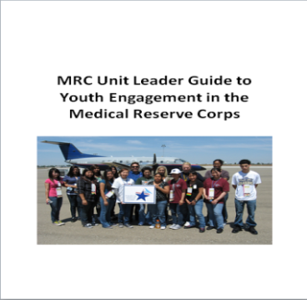
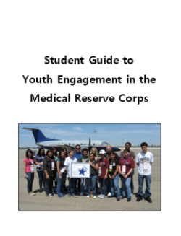
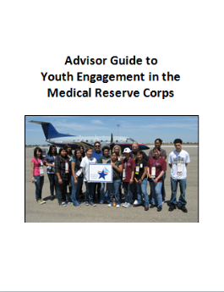
Relationship with HOSA:
Youth Engagement Guides
http://hosa.org/node/154

Slide 28

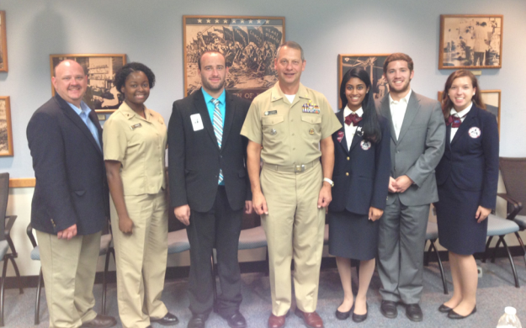
Relationship with HOSA:
Public Health Leadership Seminars

Slide 29
Relationship with HOSA:
What’s Next?

