Slide 1
Here You Go – HOSA Favorites – Part I
Jan Mould, RN, BSN, MEd

Slide 2
A Little Something for You
TAKE CARE OF YOURSELF

Slide 3
BELL RINGERS

Slide 4
Medical History Hero
Pick a figure in medical history that you admire. Write a letter to them, explaining why you admire his/her accomplishment and how it has affected your life and that of society.
HOSA connection – Exploring Medical Innovations or Medical Innovations

Slide 5
The Cost of Technology
Many benefits have been obtained through the advancements of technology. It has brought electricity, cars, planes, telephones, computers and televisions to our society. Some would argue that technology has made our life more stressful and worse. One example would be the increasing concern regarding smart phone addiction.
If you had to give up your “smart phone”, explain three ways your life would be impacted (both positive and negative).
HOSA Connection – Researched Persuasive Writing & Speaking

Slide 6
What are the three most pressing health problems in the United States today? What ideas would you suggest to address these problems?
HOSA Connection – Community Awareness, Public Health or Health Education

Slide 7
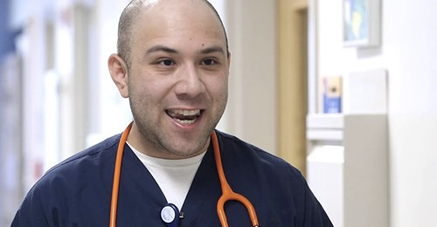
Would pediatrics be your calling?
Why be a pediatric nurse?

Slide 8
BRAIN TEASERS
The Daily Spark Critical Thinking Warm-Up Activities

Slide 9
A car tire rolls over a pebble on the road, as in the diagram below:
Which of the arrows below shows the direction in which the tire will kick the ?
HOSA Connection – Forensic Science
The Daily Spark Critical Thinking Warm-Up Activities

Slide 10
Due to the cars centripetal force on the pebble, it would be kicked directly upward. Pebbles appear to be kicked back from the car because the car is moving forward. Actually, they are moving up and down.

Slide 11
What is wrong with the reasoning of the following statement?
“Last Monday, a team of researchers randomly called 1,000 people at home between the hours of 11 am and 3 pm to determine the % of the population who had full-time jobs. Of the people surveyed, only 60% have full-time jobs. There is clearly a crisis of unemployment in this country.”
The Daily Spark Critical Thinking Warm-Up Activities

Slide 12
Answer: The survey was taken when most full- time employees would be at work.

Slide 13
At 8am, you place a certain amount of bacteria on a slide. Every hour, the area covered by the bacteria doubles. By 5pm, the slide is covered with bacteria. The area of the slide is 2 cm². At what time was half the slide covered with bacteria?
The Daily Spark Critical Thinking Warm-Up Activities

Slide 14
Answer: If the slide is completely covered at 5 pm and it doubles every hour, the slide would have been1/2 covered at 4 pm.

Slide 15
STORIES & ACTIVITIES

Slide 16
CHICKEN SOUP FOR THE TEENAGE SOUL
SPARKY – overcoming obstacles
BETTY ANN – cultural differences and acceptance

Slide 17
Gifted Hands
All beginning students read and have a written test.

