Slide 1
Defining Leadership
HOSA – Future Health Professionals

Slide 2
Definition:
Webster – “the quality of character & personality giving a person the ability to gain the confidence of and lead others”.

Slide 3
What ten characteristics do you believe are most important for a leader? List on your paper.
Notes:
When you have them listed – rate which characteristics you demonstrate one being the most and 10 being the least

Slide 4
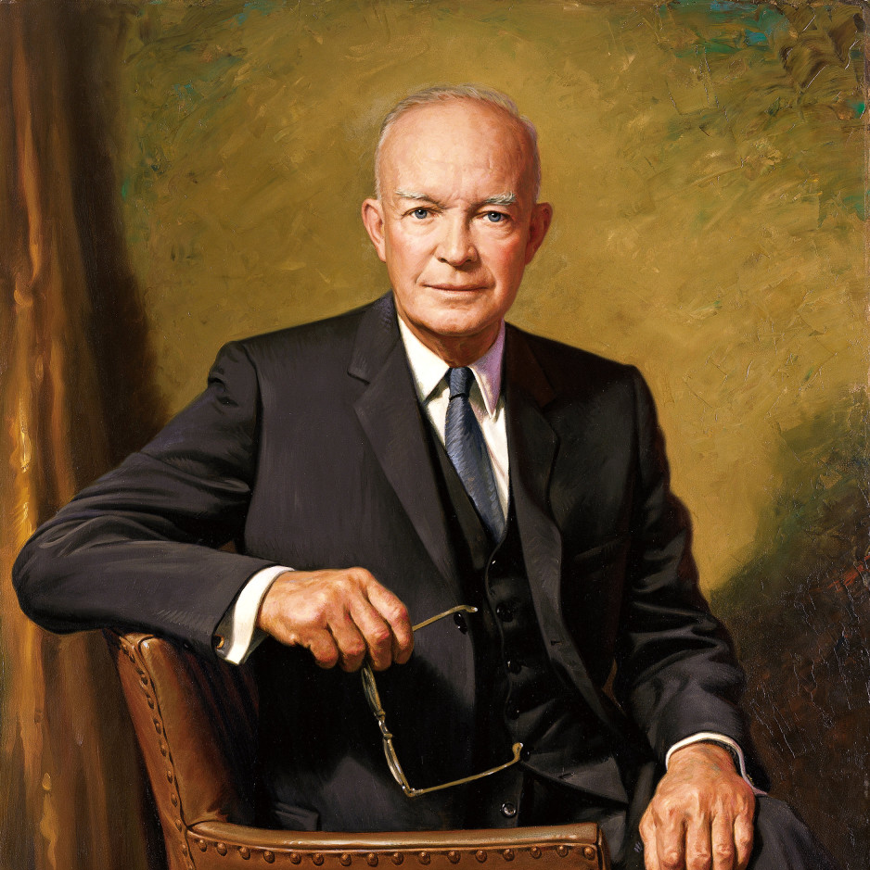
Dwight D. Eisenhower
“Leadership is the art of getting someone else to do something you want done because he wants to do it.”
Notes:
The leader does not have the largest stick and force others but according to Eisenhower begins to think it is their idea

Slide 5
The Hundred Acre Wood AA Milne
Notes:
Most of you are familiar with the 100 acre wood from your childhood. Most of you read the books or saw the movies.

Slide 6
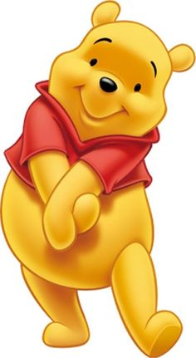
Describe the Character
Notes:
On your paper describe Winnie the Poohs characteristics

Slide 7
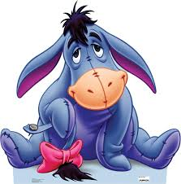
Describe the Character
Notes:
Eeyore - characteristics

Slide 8
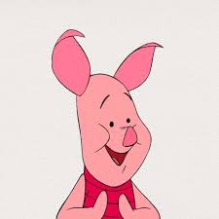
Describe the Character
Notes:
Piglet - characteristics

Slide 9
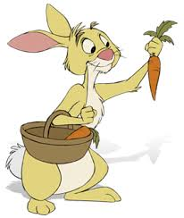
Describe the Character
Notes:
Rabbit - characteristics

Slide 10
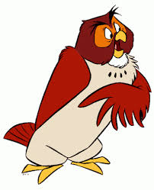
Describe the Character
Notes:
Owl - characteristics

Slide 11
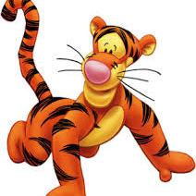
Describe the Character
Notes:
Tigger - characteristics

Slide 12
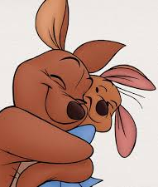
Describe the Character
Notes:
Kanga & Roo - characteristics

Slide 13
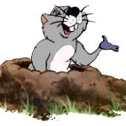
Describe the Character
Notes:
Gopher - characteristics

Slide 14
Class Discussion

Slide 15
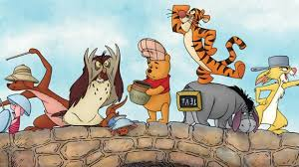
Of the characters in Winnie the Pooh- who gets your vote?

