Slide 1
Newborn Assessment
Jan Mould, RN, BSN, MEd
HOSA – Future Health Professionals

Slide 2
Critical Assessment
The initial assessment completed on a newborn must be thorough
Often problems are identified that require immediate attention including possible surgical intervention

Slide 3
Apgar Score

Slide 4
APGAR SCORING
Five factors are used to evaluate the baby's condition and each factor is scored on a scale of 0 to 2, with 2 being the best score:
Appearance (skin color)
Pulse (heart rate)
Grimace response (reflexes)
Activity (muscle tone)
Respiration (breathing rate and effort)

Slide 5
APGAR SCORING One Minute
7 to 10 baby is good, normal usual care
4 – 6 mouth or nose suctioning & possibly oxygen
3 or less resuscitation

Slide 6
APGAR SCORE 5 minutes
7 -10 normal
6 or less medical attention and further evaluation

Slide 7
First Steps
Measure
Weight
Height
Head circumference
RECTAL temp

Slide 8
Pharmacological Care
Give 1 mg vitamin K IM to promote synthesis of coagulation factors and to prevent hemorrhagic disease
Erythromycin ointment in each eye to prevent gonococcal ophthalmia and also protect against chlamydia
Blood sample from heel for blood glucose level (should be greater than 40)

Slide 9
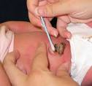
Cord Care
Examine hospital policy
Some use triple dye
Some use alcohol swabs

Slide 10
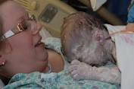
Physical Exam
Purpose:
To evaluate transition from intrauterine to extrauterine and to detect congenital malformation or actual or potential disease

Slide 11
Immediately After Birth
Brief Assessment
Respiration
Circulation
Temperature
Neurological status
Screening for anomalies or disease
Minimal disturbance of baby
Careful to not lower body temperature by excessive exposure

Slide 12
Complete Examination
Within 24 hours of birth and again prior to discharge
Observe from distance
Heart, chest & pulses before baby begins to cry

Slide 13
General Examination
POSTURE
Flexion of legs & arms when supine
Lack of posture – possible Down Syndrome or neurologic or muscle disease

Slide 14
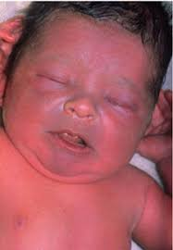
Color
CYANOSIS
If continues – obstructed airway, respiratory disease, cardiac anomalies, neurologic depression
mild is normal at birth
Tongue & mucus membranes should be pink
Peripheral cyanosis may last for a day or two

Slide 15
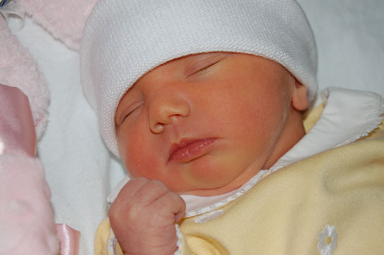
COLOR
Jaundice
Common after second day of life
Present first 24 hours suggest hemolytic process

Slide 16
SKIN
BIRTH
Vernix – cheesy white covering
Lanugo – fine hair on shoulders and back
White papules on nose and cheeks
Petechiae on scalp & face
Mongolian spots- large blue patches over lumbar, buttocks or extremities common in dark-skinned races and tend to fade over time

Slide 17
HEAD
Molding of head from pressure in pelvic area during vaginal birth
Fontanel- anterior & posterior should be soft to palpation
Anterior fontanelle 1 – 3 cm in size
Posterior fontanelle admit a fingertip
Head circumference should be between 33- 35 cm at full term

Slide 18
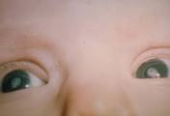
EYES
Slant upward may be indicative of Down Syndrome
Large eyes – congenital glaucoma
Too close together- possible fetal alcohol syndrome
Red reflex of light – check retina
Pupillary opacity- congenital cataracts

Slide 19
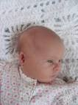
EAR
Low set ears chromosomal anomaly
Malformed ears – possible renal abnormalities
Down Syndrome – ears that fold over on top

Slide 20
NOSE, MOUTH & NECK
Nose check for patency by auscultation with a stethoscope
Babies are nose breathers for first few months of life so blockage of nasal canal can be life threatening
Neonatal tooth may be present but should be extracted
Observe for presence of a cleft
Neck checked for mass or goiter

Slide 21
CHEST & RESPIRATORY SYSTEM
Rate of respirations 40 – 60
May experience short periods of apnea
No nasal flaring or intercostal retractions
Check clavicles
Breast may excrete small amount of milk
Widely spaced nipples may indicate chromosomal anomaly

Slide 22
ABDOMEN & BACK
Umbilical cord – two arteries and one vein
Umbilical hernia is common and usually resolves before two
Tight abdomen or abdominal distention suggests intestinal obstruction or ascites
Back should be looked at for midline defects
Deep sacral dimple needs to be investigated

Slide 23
GENITAL & ANUS
Female - vaginal opening should be visible; mucous drainage present (not uncommon to be bloody)
Male: testes may not be fully descended at birth
Meatus should be located at tip of penis
Anus checked for patency, position & anal reflex

Slide 24
EXTREMITIES & HIPS
Bowing of legs is common
Should be able to place in normal position without difficulty
Hip dysplasia
More common in females
To check baby supine with the hips & knees flexed to 90; hands at end of femur (greater and lesser trochanter) click or clunk requires further evaluation

Slide 25
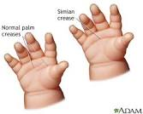
EXTREMITIES
Checked for polydactyly or syndactyly
Palm creases –most have three
Single transvers palmar crease my indicate chromosomal anomalies such as Down Syndrome

